Slide 1
Tribal-ISAC Briefing CISA Resources and Services

Slide 2
Notes:
CISA is the “Nation’s Risk Advisor”.
We lead the nation’s risk management efforts by mobilizing a collective defense of the nation’s critical infrastructure.
That means working with partners like yourselves and giving them a seat at the table to collaboratively identify risk and develop solutions.
We lead efforts to protect federal civilian networks, and collaborate with state and local governments, as well as private sector, to increase the security of theirs.
We work with our partners to prepare for, prevent and respond to cyberattacks.
And we provide services and resources designed to support individual stakeholders improve their own security, and, by extension, increase the collective defense of the whole.

Slide 4
CISA Services Catalog
Control Systems Security Program
Industrial Control Systems Cybersecurity Training
Priority Telecommunications Services
Vulnerability Scanning
(Cyber Hygiene)
Risk and Vulnerability Assessments
Phishing Campaign Assessments
CISA Tabletop Exercise Package
Cyber Incident Response, Recovery, and Cyber Threat Hunting
For more information visit www.cisa.gov/publication/cisa-services-catalog
Interoperable Communications Technical Assistance
Notes:
The CISA Services Catalog is all of CISA, in one place – a single resource that provides users with access to information on services across all of CISA’s mission areas:
You https://www.cisa.gov/publication/cisa-services-catalog.
The Catalog is interactive, allowing users to filter and quickly home in on applicable services with just a few clicks.
This Catalog is intended for electronic viewing on desktop devices only. For the most seamless experience, users should view the Catalog in full-screen mode on either their browser window or download a copy and open it with a PDF viewer.
The Stakeholder Engagement Division (SED) Awareness and Outreach team is developing an Awareness Activities Catalog to document the various CISA awareness programs and services with awareness elements. This catalog is under development, but it will highlight the various evergreen campaigns, monthly campaigns, and products and services that intend to boost public awareness on a topic.

Slide 5
Yourself - Drive cybersecurity strategy, investment and culture
Your Staff - Develop security awareness and vigilance
Your Systems - Protect critical assets and applications
Your success depends on Cyber Readiness. Both depend on you.
Your Surroundings - Ensure only those who belong on your digital workplace have access
Your Data - Make backups and avoid loss of info critical operations
Your Crisis Response - Limit damage and quicken restoration of normal operations
For more information, visit: https://www.cisa.gov/cyber-essentials
Notes:
The success of your organization depends on its “cyber readiness.”
Cyber readiness – and therefore your organization’s continued success – depend on you. Yes, YOU, the leaders.
CISA’s Cyber Essentials resource is a tool empowering business leaders to make informed decisions and actions within their organization to prioritize cybersecurity and resilience. Managing cyber risks requires building a culture of cyber readiness. There are six essential elements for building that culture:
Yourself, the Leader;
Your Staff, the Users;
Your Systems, What Makes You Operational;
Your Surroundings, the Digital Workspace;
Your Data, What the Business is Built On; and
Your Crisis Response.
Latest release is the CISA Cyber Essentials Starter Kit. Download yours at CISA.gov.
As the name suggests, the Starter Kit contains everything you need to get started, including a suite of Toolkits to go deeper into the Cyber Essentials, as well as links to additional webinars and resources.
Last Friday, we released an introductory webinar that guides viewers through the six essential elements. The webinar provides cybersecurity tips and practices, allowing leaders to be proactive in their cybersecurity planning and implementation. It can be viewed by visiting: https://www.youtube.com/watch?v=mICAaorVZVk.

Slide 6
Awareness and Outreach Campaigns
Reduce the Risk of Ransomware Campaign
Cybersecurity Awareness Month
On January 21, CISA launched its ransomware awareness campaign, “Reduce the Risk of Ransomware”, as a focused, coordinated, and sustained effort to combat ransomware.
For more information visit cisa.gov/ransomware.
On March 31, Secretary Mayorkas announced a 60-day Ransomware Sprint during which DHS will step up efforts to prevent and respond to these malicious activities. CISA will be playing a leading role in this sprint.
Every year since 2003 October has been recognized as Cybersecurity Awareness Month.
The campaign is geared towards raising awareness about the importance of cybersecurity across our Nation, ensuring that all Americans have the resources they need to be safer and more secure online.
Each week of the month highlights applicable cybersecurity best practices. Last year’s theme was “Do Your Part. #BeCyberSmart.”
National Preparedness Month
Infrastructure Security Month
National Preparedness Month (NPM) is recognized each September to promote family and community disaster planning now and throughout the year.
Last year’s theme was "Disasters Don’t Wait. Make Your Plan Today.”
Each week of the month highlights an actionable step towards increasing national preparedness.
Infrastructure Security Month is an annual effort recognized each November to educate and engage the private sector, all levels of government, and the public about the vital role critical infrastructure plays in our Nation’s wellbeing.
Last year’s themes were: The Security and Response during a Global Pandemic, and the Future of Securing Critical Infrastructure.
There are 16 critical infrastructure sectors whose assets, systems, and networks—both physical and virtual–are considered vital that their incapacitation or destruction would have a debilitating effect.

Slide 7
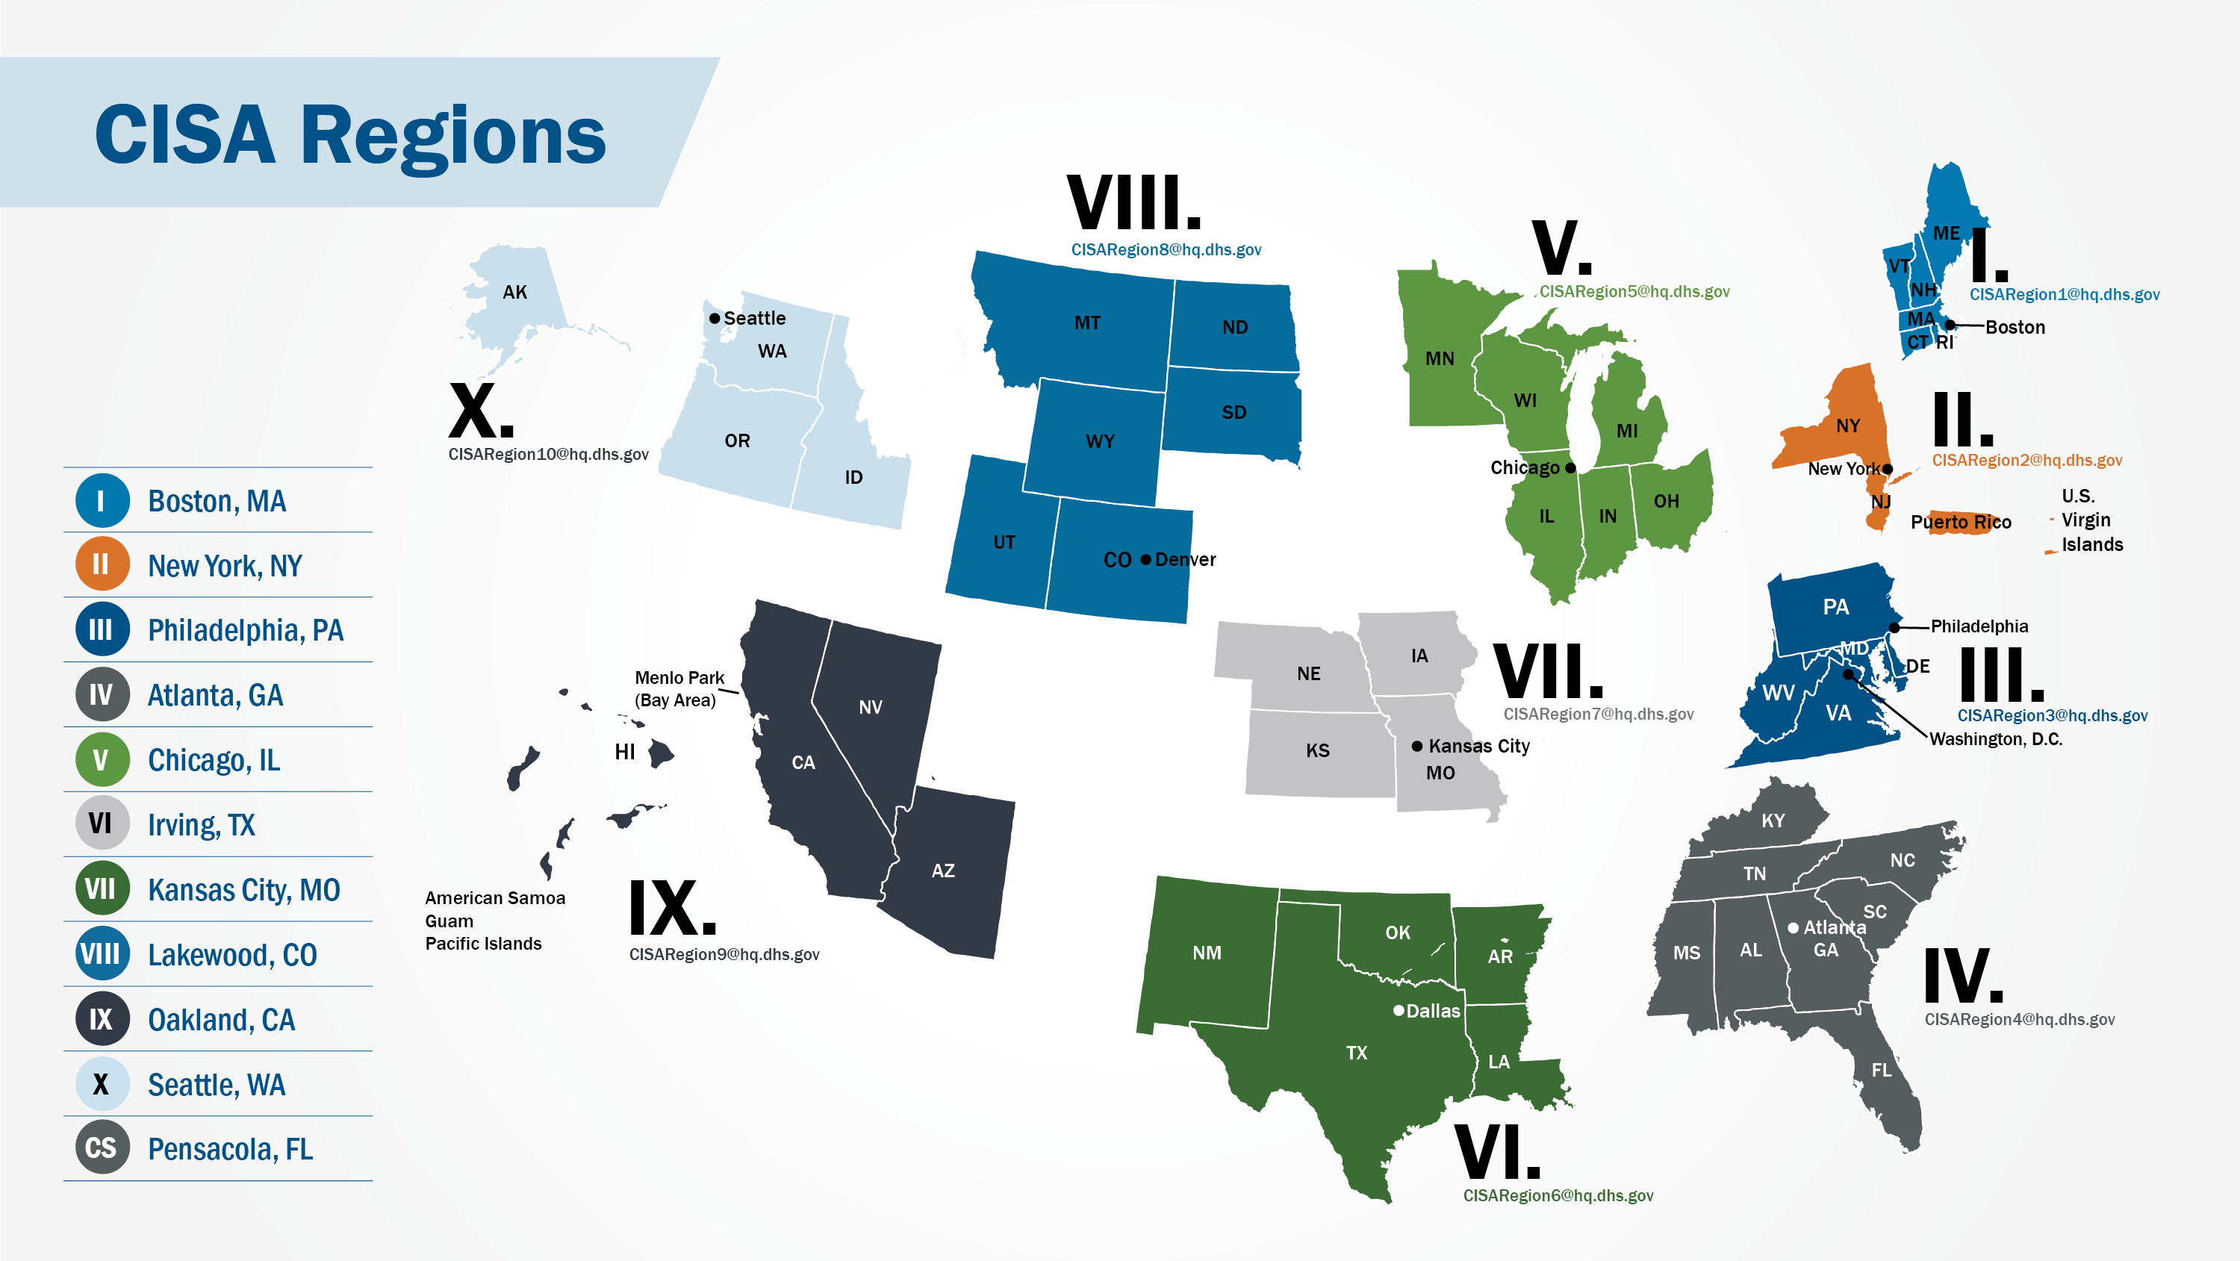
Notes:
CISA offers a host of regional support services. Within each CISA region are your local and regional Protective Security Advisors (PSAs), Cyber Security Advisors (CSAs), Emergency Communications Coordinators, and other CISA personnel. A Regional Director (RD) oversees operations throughout the region.
PSAs are trained subject matter experts in critical infrastructure protection and vulnerability mitigation. They facilitate local field activities in coordination with other Department of Homeland Security offices. They also advise and assist state, local, and private sector officials and critical infrastructure facility owners and operators.
CSAs act as liaisons to CISA services, products, and cyber programs. They off tailored briefings and assessments on emerging threats or recent incidents of interests; incident response support; assist with the adoption of the and assist with completion of no-cost cyber assessments.
Emergency Communications Coordinators offer training, tools, workshops, and regional support. These services assist CISA stakeholders in ensuring they have communications during steady and emergency operations and facilitate the delivery of no-cost technical assistance.

Slide 8
Regional Contacts
Region | Regional Supervisory Outreach Coordinator (RSOC) | Email
Region I | Tracy Shawyer | tracy.shawyer@cisa.dhs.gov
Region II | Dan Mackey | daniel.mackey@hq.dhs.gov
Region III | John French | john.french.2@hq.dhs.gov
Region IV | Sabrina Smith | sabrina.smith@cisa.dhs.gov
Region V | Sam Duchac | samuel.duchac@hq.dhs.gov
Region VI | Michael Dailey | Michael.a.dailey@cisa.dhs.gov
Region VII | David Teska | david.teska@cisa.dhs.gov
Region VIII | Dorothy Savola | dorothy.savola@cisa.dhs.gov
Region IX | Merideth Secor | merideth.secor@cisa.dhs.gov
Region X | Barrett Adams-Simmons | Amanda.Adams-Simmons@cisa.dhs.gov
Notes:
The Regional Supervisory Outreach Coordinators (RSOCs) are your main POCs for the regional offices

Slide 9
Tribal Emergency Communications Program
For more information, visit: https://www.cisa.gov/tribal-emergency-communications-program
Governance Support:
CISA interacts with tribes to establish and maintain collaborative and trusted relationships to support information and resource sharing; identify opportunities to strengthen tribal communications governance and infrastructure; and identify and document lessons learned and best practices to help CISA improve operable and interoperable communications service offerings to the public safety community.
Technical Assistance Support:
CISA coordinates outreach on multiple platforms to inform tribal leaders and officials about the services that CISA’s Interoperable Communications Technical Assistance Program provides at no cost to tribes. Access more information at cisa.gov/interoperable-communications-technical-assistance-program.
Priority Services Support:
CISA connects tribes with Priority Telecommunications Services, when applicable, which provide officials from national security and emergency preparedness (NS/EP) disciplines priority communications capabilities during congested scenarios and emergency circumstances.
Information Sharing and Resources:
CISA provides tribes with access to multiple resources, guidance documents, and tools to improve multi-jurisdictional and intergovernmental communications interoperability of existing communications systems and future networks through technologies and processes.
Partnership Coordination:
CISA facilitates collaboration through multiple partnerships and working groups comprised of participants from all levels of government, including tribes. These partnerships and groups enable information and resource sharing and provide a forum to strengthen NS/EP infrastructure, develop tools and resources, and provide a voice in the public safety communications community.
Notes:
CISA’s Tribal Emergency Communications Program’s mission is to supports Native American and Alaska Native tribes through consultative engagement, outreach, advocacy, technical assistance, and inter- and intra-agency coordination to ensure strengthened public safety operable and interoperable communications.
Their vision is to develop and strengthen communications infrastructure for Native American and Alaska Native Tribes in the interests of public safety and human services.
Each tribe has unique cultures, capabilities, needs, and challenges. CISA works individually with tribal communities to establish collaborative relationships to foster a cultural and technical understanding of each community and its emergency communications framework.
CISA assesses and documents how their customs, public safety communications capabilities, challenges, infrastructure, and current governance structures impact decision-making, management, and resource allocation. This process has provided tribes access to CISA’s tailored solutions and resources and opened the door to relationships with other federal agencies and state, regional, and local public safety entities.
CISA’s communications governance support may benefit a tribe through:
Relationship Building: Assisting with establishing and developing collaborative relationships across all levels of government
Accessibility to Services and Resources: Identifying opportunities to utilize CISA services, resources, and tools to enhance emergency communications capabilities through technical assistance, priority telecommunications services, and grant guidance
Communications Support: Communicating their current emergency management capabilities and challenges to tribal leadership, as well as to public safety partners at all levels of government
Strategic Planning Support: Assisting with planning and implementing holistic communications operability and interoperability to expand and strengthen public safety services for their tribal community and neighboring jurisdictions
CISA’s Interoperable Communications Technical Assistance Program (ICTAP) provides technical assistance at no cost to tribal communities to enhance operable and interoperable communications capabilities. Service offerings include:
Governance assessment, planning, documentation, and development
Communications planning and standard operating procedure (SOP) assessment, development, and implementation support
Technology planning, training, and implementation
Training and exercise planning and execution support
Priority Services
CISA’s Priority Telecommunications Services program offers national security and emergency preparedness (NS/EP) and response personnel priority voice and data circuit access and communications capabilities during landline and wireless network congestion and emergency circumstances. These services are provided at little or no cost to the tribe.
Partnership Coordination
CISA facilitates collaboration through multiple partnerships and working groups comprised of participants from all levels of government. These partnerships and groups enable information and resource sharing and provide a forum to strengthen NS/EP infrastructure, develop tools and resources, and provide a voice in the public safety communications community.
Tribal NS/EP personnel can participate in the following:
SAFECOM
Southwest Border Communications Group (SWBCWG)
Canada-United States Communications Interoperability Working Group (CANUS-CIWG)
Federal Partnership for Interoperable Communications

Slide 10
Upcoming Events
DHS Virtual Tribal Summit: August 9-13, 2021
CISA Cyber Summit: September 2021
Chemical Sector Summit: November 2021
The Chemical Security Summit, hosted by the Cybersecurity and Infrastructure Security Agency (CISA) in collaboration with the Chemical Sector Coordinating Council (SCC), is the signature industry event for chemical representatives across the chemical and interconnected sectors—including energy, communications, transportation, and water—to learn, share perspectives, and engage in dialogue. Securing chemicals in an evolving threat environment requires cross collaboration between facility owners and operators, industry, law enforcement, community members, and all levels of government.
The Department of Homeland Security, Cybersecurity and Infrastructure Security Agency (CISA) will bring together critical infrastructure stakeholders from around the world to a forum with presentations focused on emerging technologies, vulnerability management, incident response, risk mitigation, and other current cybersecurity topics. The Summit provides the opportunity for Federal, state, local, tribal, and territorial agencies, private sector organizations, and international partners to highlight successes and opportunities for collective action.
During the week of August 9-13, the Department of Homeland Security is hosting a tribal government, tribal organization, and tribal enterprise centric gathering to share lessons learned and experiences across the homeland security arena. We will gather for a couple of hours with some regional and sector breakouts.

Slide 11
Key Points of Contact
Tribal Partnerships, Stakeholder Engagement Division, CISA
Mark Stidd, mark.stidd@cisa.dhs.gov
SLTT Partnerships, Cybersecurity Division, CISA
David Stern, david.stern@cisa.dhs.gov
Awareness and Outreach, Stakeholder Engagement Division, CISA
Jay Covington, justin.covington@cisa.dhs.gov
CISA Tribal Emergency Communications Program
Jessica Kaputa, jessica.kaputa@cisa.dhs.gov
DHS Intergovernmental Affairs
David Munro, Director of Tribal Affairs david.munro@hq.dhs.gov
ISAO Standards Organization (www.isao.org)
Larry Sjelin, Larry.Sjelin@utsa.edu
Natalie Sjlein, natalie.sjelin@utsa.edu

Slide 12
For more information:
CISA Tribal Affairs
cisatribalaffairs@cisa.dhs.gov
Questions?

